Slide 1



ＡＩ ＆ Ｂｉｇ Ｄａｔａ
Ｃ Ｐｒｏｇｒａｍｍｉｎｇ (W2)
Welcome!!
Please check attendance individually.
(Mobile App)
miricanvas.com
Notes:
001 분반 보강 날짜 확인 (3/12)

Slide 2
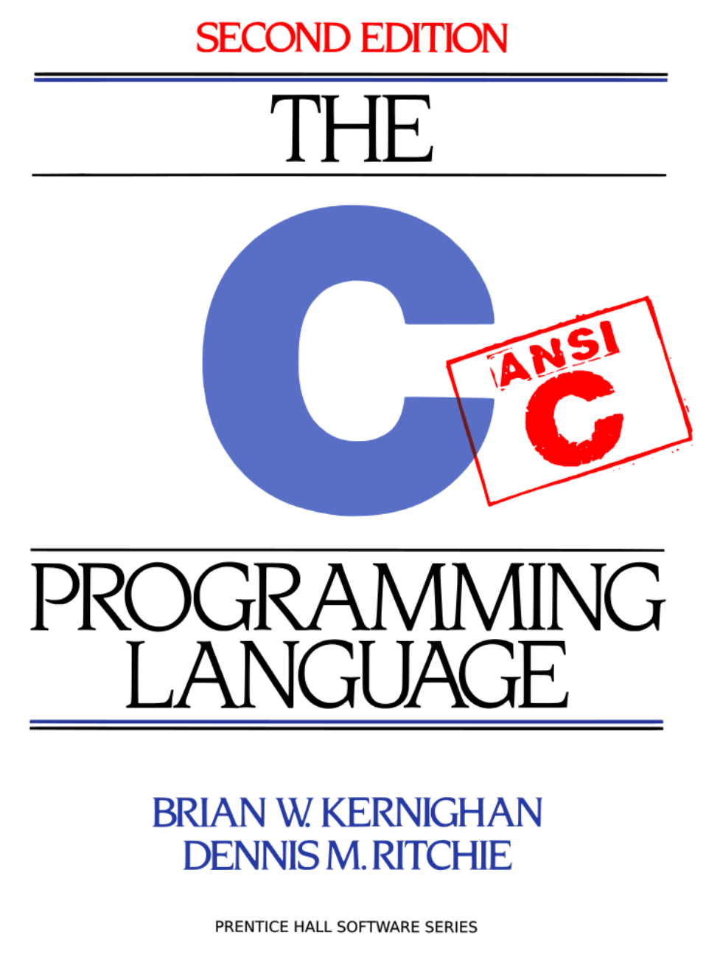

ＡＩ ＆ Ｂｉｇ Ｄａｔａ
Reference
The C Programming Language 2nd Edition
https://seriouscomputerist.atariverse.com/media/pdf/book/C%20Programming%20Language%20-%202nd%20Edition%20(OCR).pdf
Any book related to C is fine

Slide 3

ＡＩ ＆ Ｂｉｇ Ｄａｔａ
Reference
C언어 Express (개정4판)
저자 : 천인국
브랜드 : 생능출판사
Any book related to C is fine

Slide 4
ＡＩ ＆ Ｂｉｇ Ｄａｔａ
Things to do today
01
Finish development environment
Codespaces (for 004)
02
Upload folders & files to your github
https://github.com/prof-kweon/C-Language-Course/blob/main/LectureReference/Howto-github.md
03
Register Codyssey & A/B group → Weekly schedule
04
Codyssey (how to evaluate & review)

Slide 5

ＡＩ ＆ Ｂｉｇ Ｄａｔａ
Practice
Implement Step 1, Course 1, Problem 1
Upload the source code of C1-P1
Peer evaluation
Make requirement list for C1-P2

Slide 6
ＡＩ ＆ Ｂｉｇ Ｄａｔａ
Homework
1.

Slide 7
ＡＩ ＆ Ｂｉｇ Ｄａｔａ
See you next week!
DO NOT miss the classes
miricanvas.com

Slide 8
ＡＩ ＆ Ｂｉｇ Ｄａｔａ
Hello world
#include <stdio.h>
int main() {
printf("Hello, World!\n");
return 0;
}
print("Hello, World!")
#include <iostream>
int main() {
std::cout << "Hello, World!" << std::endl;
return 0;
}
public class HelloWorld {
public static void main(String[] args) {
System.out.println("Hello, World!");
}
}

